Slide 1

SREENIVASA INSTITUTE OF TECHNOLOGY AND MANAGEMENT STUDIES
(Autonomous-NBA Accrediated)
DEPARTMENT OF COMPUTER SCIENCE AND ENGINEERING
(2024-2025)
A FINAL YEAR PROJECT PRESENTATION
ON
HYBRID APPROACH FOR CRUDE OIL PRICE PREDICTION USING PROPHET AND GRU
BY
A Geethika | 21751A0502
G Ramya | 21751A0559
G Divyanjali | 21751A0558
C Preethi | 21751A0531
Under the Guidance of
Mrs. ARCHANA S, M.Tech., (Ph.D).,
Assistant Professor,
Department of Computer Science and Engineering,
Sreenivasa Institute of Technology and
Management Studies, Chittoor, A.P.

Slide 2
ABSTRACT
This project presents a hybrid approach for crude oil price forecasting by integrating Prophet for long-term trend analysis and GRU (Gated Recurrent Unit) for short-term price predictions, with Grey Wolf Optimizer (GWO) enhancing GRU’s hyperparameters for improved accuracy. The workflow begins with Prophet capturing long-term price trends and seasonal variations, followed by GRU, which learns short-term dependencies and fluctuations. GWO fine-tunes GRU’s hyperparameters, for the better performance. The final hybrid model combines the predictions from Prophet and optimized GRU for ensuring a balanced and reliable forecast. Model performance is evaluated using MAE, RMSE, MAPE to ensure robustness. Additionally, a flask based GUI allows users to interact with the model, visualize predictions, and analyze historical trends in real time.

Slide 3
PROBLEM IDENTIFICATION
Crude oil prices are highly volatile, making accurate forecasting difficult.
Traditional models fail to capture both long-term trends and short-term fluctuations.
Existing statistical and machine learning approaches lack accuracy.
Effective hyperparameter tuning is required for better performance.
A hybrid approach combining statistical and deep learning methods is needed.
Real-time visualization and model comparison are essential for practical use.

Slide 4
INTRODUCTION
Crude oil price prediction is essential for economic stability, investment decisions, and energy market operations. The fluctuating nature of prices, influenced by geopolitical events, supply-demand dynamics, and macroeconomic factors, makes accurate forecasting a challenging but necessary task.
This forecasting helps predict future prices based on historical trends and market factors, aiding financial markets, economic planning, and risk management.
This project introduces a hybrid forecasting model combining Prophet for long-term trends, GRU for short-term fluctuations, and Grey Wolf Optimizer (GWO) for hyperparameter tuning. And the model is evaluated using performance metrics like MAE, RMSE,MAPE.

Slide 5
OBJECTIVE
The main Objective of this project is to develop a highly accurate crude oil price forecasting system by combining Prophet for long-term trend prediction and GRU for short-term price fluctuations, optimized using Grey Wolf Optimizer (GWO).
This hybrid approach aims to improve prediction precision, outperform traditional models, and provide real-time forecasting through an interactive Flask based GUI for better financial and strategic decision-making.

Slide 6
LITERATURE SURVEY
S.NO | Title (Year) | Authors | Algorithms | Remarks
1 | Multi-Step Crude Oil Price Prediction Using LSTM Tuned by Salp Swarm Algorithm (2022) | Luka Jovanovic et al. | LSTM, Salp Swarm Algorithm (SSA) | SSA optimizes LSTM for improved multi-step crude oil price forecasting.
2 | Price Forecasting Using Neural Networks (2024) | Bingzi Jin, Xiaojie Xu | Neural Networks | Neural networks effectively predict crude oil and energy prices for market analysis.

Slide 7
LITERATURE SURVEY
S.No | Title (Year) | Authors | Algorithms | Remarks
3 | Hybrid Model for Crude Oil Price Forecasting (2020) | Hamed Abdollahi | Time Series Decomposition | Hybrid model improves crude oil price forecasting accuracy.
4 | Oil Market Forecasting Using Social Media (2021) | Binrong Wu, Lin Wang, Sirui Wang, Yu-Rong Zeng | RNN LSTM | Social media data improves oil market forecasting during COVID-19.

Slide 8
LITERATURE SURVEY
S.No | Title (Year) | Authors | Algorithms | Remarks
5 | Big Data Analytics in Oil & Gas (2020) | Trung Nguyen, R. Gosine, P. Warrian | Systematic Review | Analyzes big data adoption challenges and opportunities in the oil industry
6 | ML Applications in Oil & Gas (2021) | Zeeshan Tariq et al. | ANN,SVM,CNN | Reviews ML use in exploration, drilling, and production, highlighting future prospects.

Slide 9
LITERATURE SURVEY
S.No | Title (Year) | Authors | Algorithms | Remarks
7 |  | Zilin Xu et al. | ARIMA, GARCH, ANN | ANN outperforms traditional econometric models in WTI price prediction.
8 | Crude Oil Price Forecasting (2021) | Quanying Lu et al. | GLMNET, SSL, BMA, LSTM | LSTM with variable selection improves forecasting accuracy.
Crude Oil Price Forecasting (2023)

Slide 10
LITERATURE SURVEY
S.No | Title (Year) | Authors | Algorithms | Remarks
9 | Crude Oil Price Prediction (2021) | Ganiyu A. Busari, Dong H. Lim | AdaBoost-LSTM, AdaBoost-GRU | Ensemble methods improve forecasting accuracy.
10 | Crude Oil Price Forecasting (2021) | Tianyu Zhang et al. | VMD, EEMD, PSO, KELM | Hybrid model improves multi-step forecasting accuracy.

Slide 11
EXISTING METHOD
It uses a hybrid model combining statistical and machine learning techniques.
Based on Ensemble Empirical Mode Decomposition (EEMD), ARIMA, SVM, and LSTM.
EEMD decomposes crude oil price data into Intrinsic Mode Functions (IMFs).
IMFs are classified into stochastic and deterministic components.
ARIMA, SVM, and LSTM are applied to respective components for prediction.
Final forecast is obtained by aggregating individual model predictions.
Provides improved accuracy over standalone models but has high computational complexity.

Slide 12
DISADVANTAGES OF EXISTING SYSTEM
High Computational Complexity – Multiple steps for decomposition and forecasting increase processing time.
Limited Feature Consideration – Lacks external factors like exchange rates and geopolitical influences.
Dependency on Decomposition Accuracy – Errors in IMF reconstruction affect prediction reliability.
Model Performance Constraints – ARIMA struggles with non-stationary data, SVM lacks deep temporal insights.

Slide 13
PROPOSED SYSTEM
The proposed system integrates Prophet for long-term trend analysis and GRU for short-term price prediction.
Grey Wolf Optimizer (GWO) enhances GRU’s hyperparameter tuning for improved accuracy.
Eliminates complex decomposition techniques, making forecasting more efficient and reliable.
Flask based GUI enables real-time forecasting, visualization, and model comparison.
Performance evaluation includes MAE, RMSE, MAPE for accuracy assessment.
Provides a scalable, user-friendly, and high-accuracy solution for crude oil price forecasting.

Slide 14
ADVANTAGES OF PROPOSED SYSTEM
Improved Prediction Accuracy – Combines Prophet for long-term trends and GRU model for short-term predictions, with GWO for hyperparameter tuning.
Reduced Computational Complexity – Eliminates the need for decomposition techniques like EEMD, simplifying implementation while maintaining accuracy.
Better Handling of Non-Stationary Data – Prophet manages seasonal variations, while GRU captures short-term fluctuations for a balanced forecast.
Optimized Hyperparameters – GWO fine-tunes GRU parameters, reducing risks of overfitting and underfitting.
Scalability & Flexibility – Can be extended to predict other energy commodities like natural gas and electricity prices.

Slide 15
HARDWARE &SOFTWARE REQUIREMENTS
HARDWARE REQUIREMENTS
Processor: Intel i5
RAM: 16GB
Storage: 512GB PCIe 3.0 NVMe M.2 SSD
GPU : NVIDIA CUDA-enabled for deep learning
SOFTWARE REQUIREMENTS
OS: Windows 11
Language: Python 3.11
IDE: Jupyter Notebook

Slide 16
ALGORITHMS
Prophet Forecasting Model
Predict long-term trends in crude oil prices.
Developed by Facebook, Prophet is a time series forecasting algorithm based on additive models.
Formula:
y(t)=g(t)+s(t)+h(t)+ϵ
g(t) is the trend (linear or logistic growth), s(t) is the seasonality (yearly, weekly, daily), h(t) represents holidays or event effects, ϵ is the error term.
Input: Preprocessed crude oil time series
Output: Trend forecast (Prophet_pred)
Residual = Actual - Prophet_pred

Slide 17
2. GATED RECURRENT UNIT
Predict short-term residuals (errors) from Prophet model.
Handles sequential dependencies in residual data.
GRU is a type of RNN (Recurrent Neural Network) designed to capture temporal dependencies without vanishing gradients.
Uses update gate and reset gate to control flow of information:
Update Gate (z_t): Decides how much past information to retain.
Reset Gate (r_t): Decides how much past information to forget.
Input: Time-sequenced residuals
Output: Predicted residual

Slide 18
3. GREY WOLF OPTIMIZER
Optimizes hyperparameters of the GRU model (layers, units, learning rate, etc.)
Nature-inspired algorithm based on grey wolf hunting behavior.
Imitates leadership hierarchy:
Alpha (best solution)
Beta (second-best)
Delta (third-best)
Omega (the rest)
Wolves update their positions in the solution space by surrounding the prey (optimal solution).
Used to find the best configuration of GRU (by minimizing RMSE on validation data)
Helps boost model accuracy and performance.

Slide 19
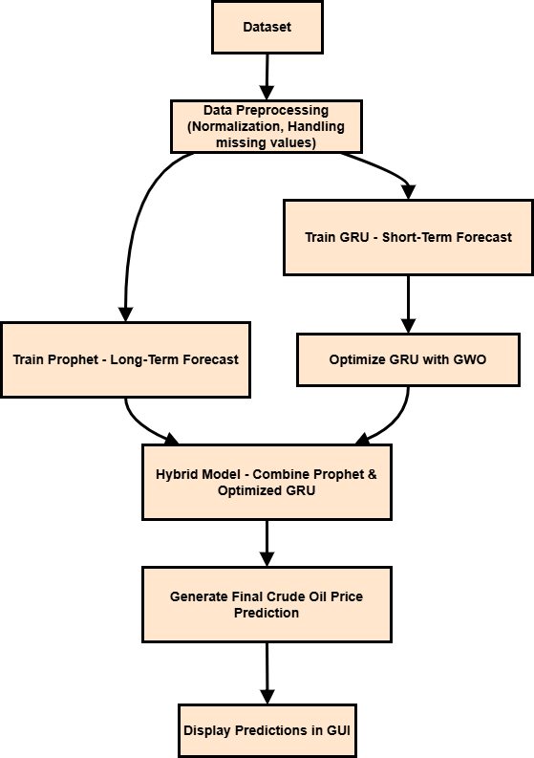
ACHITECTURE

Slide 20
MODULES
Data Acquisition and Preprocessing Module
Long-Term Trend Forecasting Module
Short-Term Volatility Prediction Module
Adaptive Hyperparameter Optimization Module
Hybrid Forecasting Integration Module
Model Performance Evaluation Module
Interactive Prediction and Visualization Module

Slide 21
MODULE DISCRIPTION
Data Acquisition & Preprocessing
Collects, cleans, and structures data for forecasting.
Normalizes prices, formats dates, and removes inconsistencies.
Long-Term Trend Forecasting Module
Uses Facebook Prophet to predict trends up to 365 days.
Captures seasonality and historical patterns with visualizations.
Short-Term Volatility Prediction Module
Implements GRU for 30-day short-term price forecasting.
Learns sequential dependencies for accurate predictions.
Adaptive Hyperparameter Optimization Module
Optimizes GRU using Grey Wolf Optimizer (GWO).
Enhances accuracy by tuning learning rate, batch size, etc.

Slide 22
Hybrid Forecasting Integration Module
Combines Prophet (long-term) and Optimized GRU (short-term).
Improves forecasting precision with a balanced approach.
Model Performance Evaluation Module
Assesses Prophet, GRU, and Hybrid models using MAE, RMSE, and MAPE.
Compares actual vs. predicted prices through visual reports.
Interactive Prediction & Visualization
Flask based GUI for real-time forecasting and model comparison.
Allows users to upload data and visualize trends dynamically.

Slide 23
Methodology
1. Data Collection & Preprocessing
Source: Historical crude oil dataset (`Crude oil.csv`) with over 5000 entries.
Features used: Date, Close/Last, Open, High, Low, Volume.
The Steps:
Handle missing values and format dates.
Normalize data for GRU.
Split into training and testing sets.
2. Long-Term Trend Prediction using Prophet
Implement Facebook Prophet to model long-term trends.
Tune seasonalities and changepoint sensitivity.
Generate trend forecasts.

Slide 24
3. Residual Forecasting using GRU
Train a GRU (Gated Recurrent Unit) model on residuals.
GRU captures short-term temporal dependencies.
Input: Time-windowed residual sequences.
Output: Predicted residuals.
4. GRU Hyperparameter Optimization using GWO
Apply Grey Wolf Optimizer to find optimal GRU parameters:
Layers, neurons, dropout, epochs, learning rate, etc.
Objective: Minimize validation RMSE.
5. Hybrid Model Construction
Combine Prophet trend and GRU residual outputs:
Final Prediction=α⋅Prophet+(1−α)⋅GRU
Optimize weight α to minimize RMSE.

Slide 25
6. Evaluation & Visualization
Metrics: RMSE, MAE, MAPE, R² Score.
Visualizations:
Actual vs Predicted table.
7-day future forecast.
Error comparison across models.
7. Web Application Deployment
Frontend: Flask + Bootstrap interface.
Backend: Hybrid model prediction logic in Python.
Features:
Login/Register (MySQL DB)
Predict for past & future dates

Slide 26
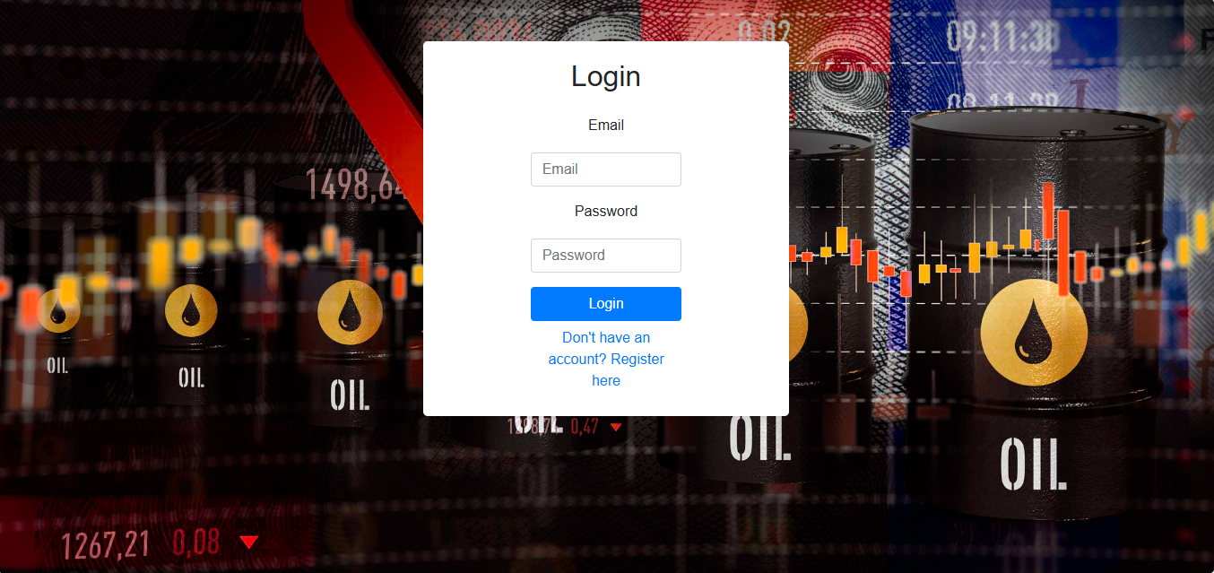
OUTPUT

Slide 27
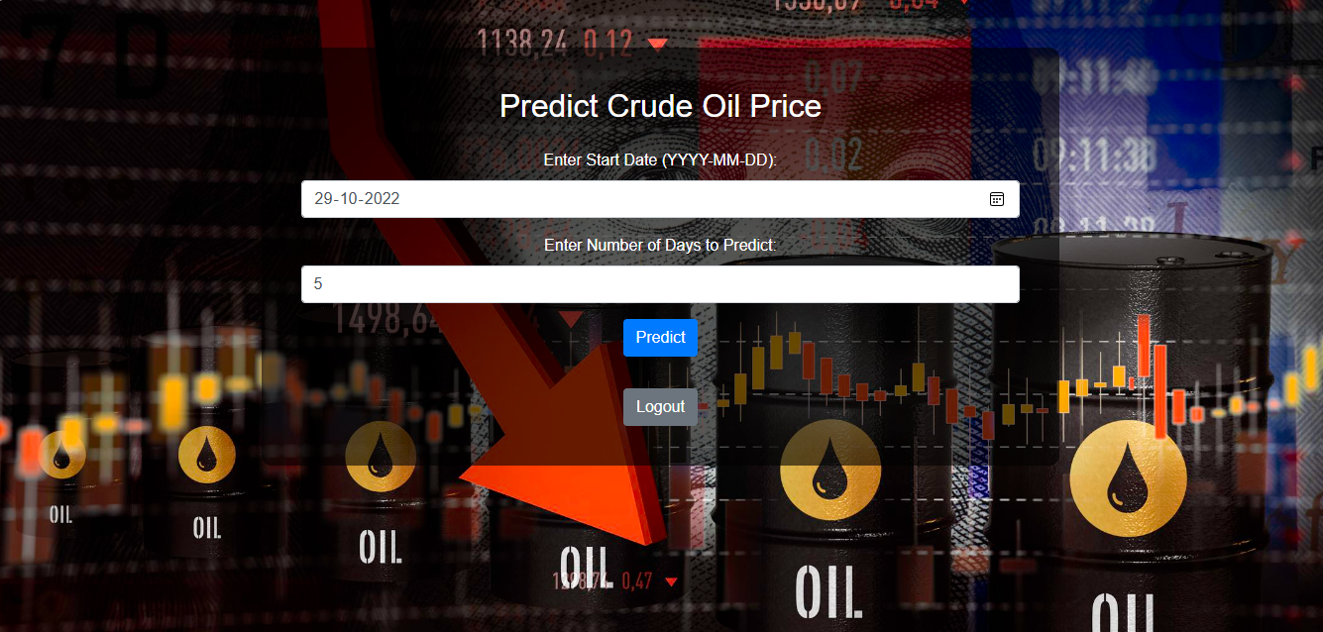

Slide 28
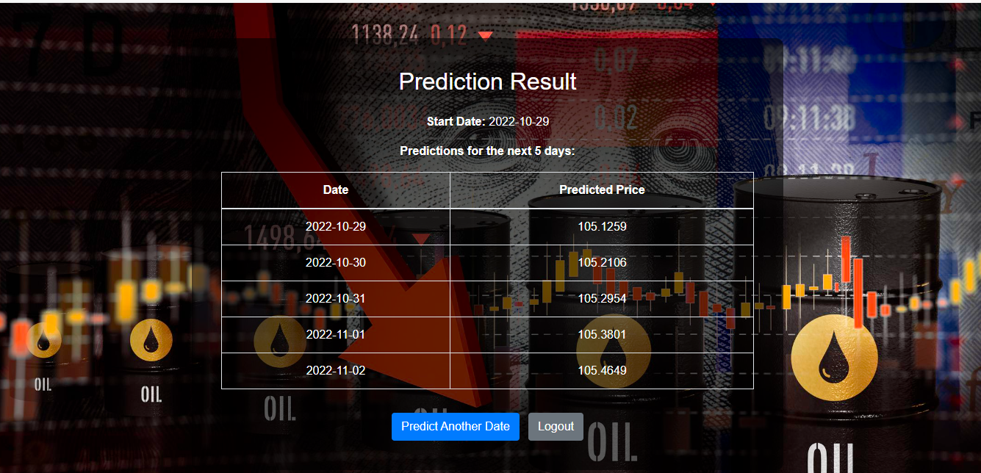

Slide 29
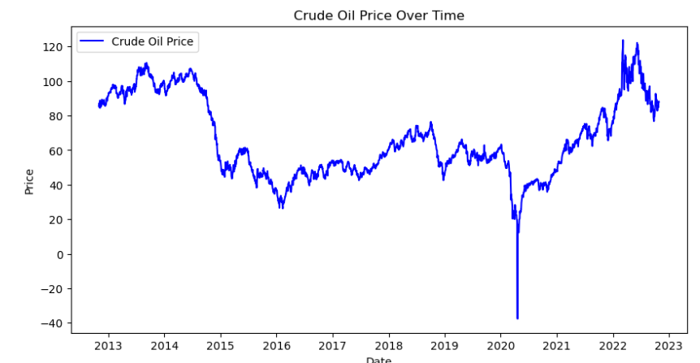
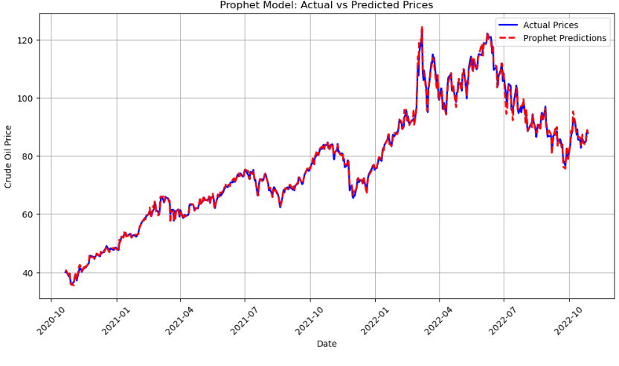

Slide 30
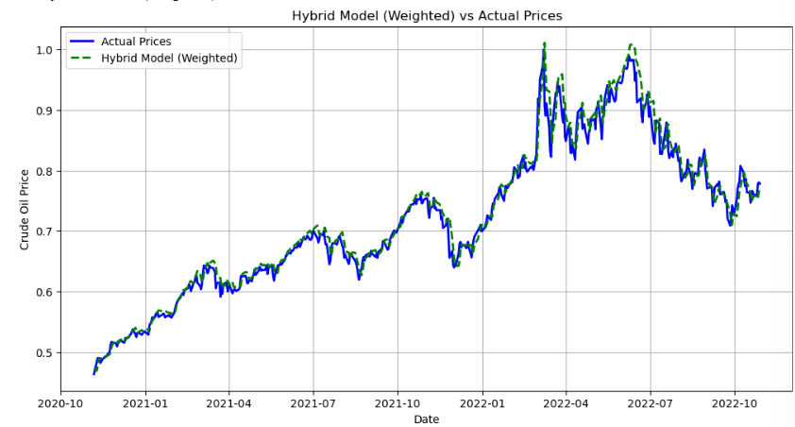
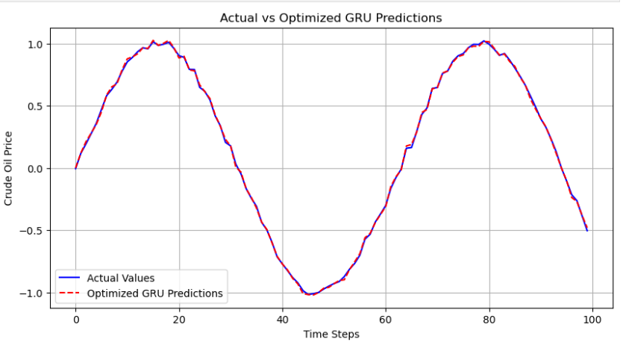

Slide 31
Comparision Table
Model | MAE | RMSE | R2 Score
Prophet | 0.684 | 1.005 | 0.997
Optimized GRU (GRU) | 0.012 | 0.016 | 0.976
Hybrid Model | 0.011 | 0.018 | 0.982

Slide 32
REFERENCES
M. Naeem, M. Aamir, J. Yu, and O. Albalawi, "A Novel Approach for Reconstruction of IMFs of Decomposition and Ensemble Model for Forecasting of Crude Oil Prices," IEEE Access, vol. 12, pp. 34192-34206, 2024. doi: 10.1109/ACCESS.2024.3370440
Z. Tao, M. Wang, J. Liu, and W. Piao, "A Functional Data Analysis Framework Incorporating Derivative Information and Mixed-Frequency Data for Predictive Modeling of Crude Oil Price," IEEE Transactions on Industrial Informatics, vol. 21, no. 1, pp. 1–10, Jan. 2025. doi: 10.1109/TII.2024.3523571
Z. Tao, M. Wang, J. Liu, and W. Piao, "A Functional Data Analysis Framework Incorporating Derivative Information and Mixed-Frequency Data for Predictive Modeling of Crude Oil Price," IEEE Transactions on Industrial Informatics, vol. 21, no. 1, pp. 1–10, Jan. 2025. doi: 10.1109/TII.2024.3523571

Slide 33
REFERENCES
O. Sultonov and J. Choi, "From Prediction to Profit: A Comprehensive Review of Cryptocurrency Trading Strategies and Price Forecasting Techniques," IEEE Access, vol. 12, pp. 87039–87064, 2024. doi: 10.1109/ACCESS.2024.3417449
J. Wu, J. Dong, Z. Wang, Y. Hu, and W. Dou, "A novel hybrid model based on deep learning and error correction for crude oil futures prices forecast," Resources Policy, vol. 83, 2023, Art. no. 103602. doi: 10.1016/j.resourpol.2023.103602
P. O. Odion, A. Abdulrauf, O. B. Abodunrin, and A. Y. Adam, "A Review of Machine Learning Models Used in Forecasting of Petroleum Products Prices," Bima Journal of Science and Technology, vol. 8, no. 4A, pp. 94–109, Dec. 2024. doi: 10.56892/bima.v8i4.1148

Slide 34
REFERENCES
J. Nasir, M. Aamir, Z. ul Haq, S. S. Khan, M. Y. Amin, and M. Naeem, "A New Approach for Forecasting Crude Oil Prices Based on Stochastic and Deterministic Influences of LMD Using ARIMA and LSTM Models," IEEE Access, vol. 11, pp. 14322–14339, 2023. doi: 10.1109/ACCESS.2023.3243232
S. Zhang, H. Wu, J. Wang, and L. Du, "Hybrid Deep Learning for Gas Price Prediction Using Multi-Factor and Temporal Features," IEEE Access, vol. 12, pp. 1–10, 2024. doi: 10.1109/ACCESS.2024.3525128
Z. J. Peng, C. Zhang, and Y. X. Tian, "Crude Oil Price Time Series Forecasting: A Novel Approach Based on Variational Mode Decomposition, Time-Series Imaging, and Deep Learning," IEEE Access, vol. 11, pp. 82216–82231, 2023. doi: 10.1109/ACCESS.2023.3301576

Slide 35
REFERENCES
M. Liu and L. Ding, "A Medium to Long-Term Multi-Influencing Factor Copper Price Prediction Method Based on CNN-LSTM," IEEE Access, vol. 11, pp. 69458–69473, 2023. doi: 10.1109/ACCESS.2023.3288486
A. Antwi, S. Li, and L. Yu, "Modeling and Forecasting Commodity Futures Prices: Decomposition Approach," IEEE Access, vol. 10, pp. 17954–17966, 2022. doi: 10.1109/ACCESS.2022.3152694

Slide 36


